Slide 1
Regularized Regression Models
Jasmine Wilkerson

Slide 2
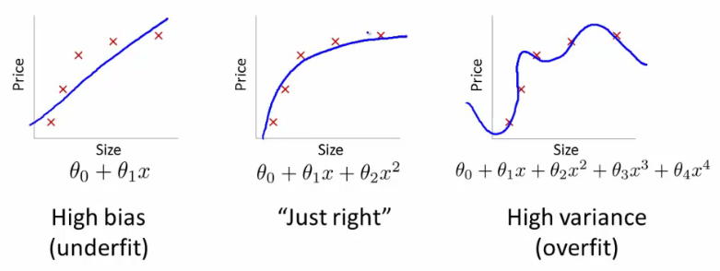
Linear regression fitting example

Slide 3
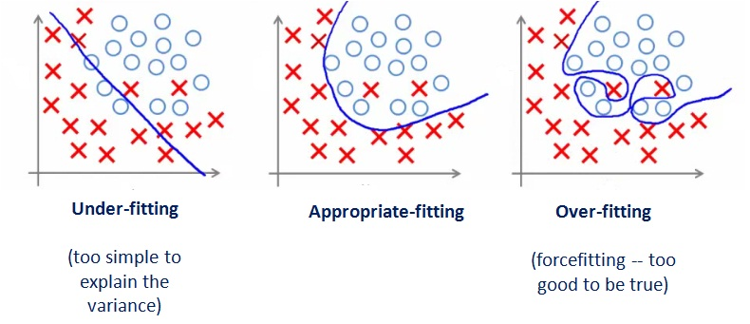
Logistic regression fitting example

Slide 4
Overfitting
Overfitting when……
Complex model, too many features, not enough training samples.
How to address overfitting??
Go through each features to decide which to keep.
Use model selection algorithm to automatically choose features.

Slide 5
Idea of Regularization
Keep all the features, but reducing their magnitude of parameter effects in model.
Shrink θ_{j} parameters

Slide 6
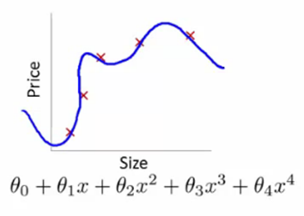

Regularized regression intuition
Close to zero
Goal: To minimize cost function θ_{j}
Suppose we penalize and make θ₃ and θ₄ very small
+1000 θ₃ + 1000 θ₄

Slide 7
Regularization
Two common types of regularization in linear regression
L2 regularization (a.k.a ridge regression)
L1 regularization (a.k.a lasso regression)

Slide 8
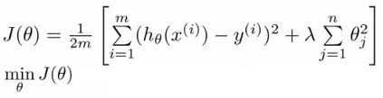
Regularized-Ridge regression
Regularization by shrink θ_{j} smaller values, as a result
“less complex” hypothesis function without eliminating features
More protection from overfitting.
L2: Ridge regression

Slide 9
Regularized-Ridge regression
Goal 1: find the best fit
Goal 2: keep parameter θ_{j} small
λ is regularization parameter to controls a trade off

Slide 10
Regularized-Ridge regression
If λ is too large, θ_{j} become too small, as if features have no effect in predicting response.
If λ is too small, θ_{j} are not regularized.

Slide 11
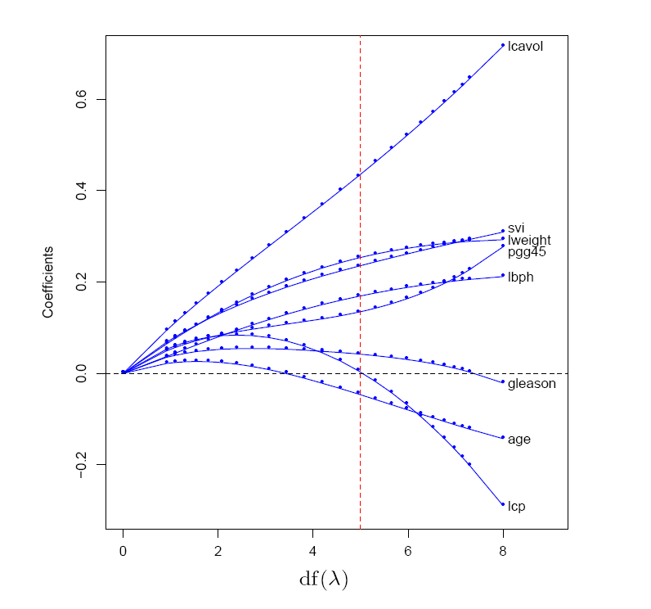
Ridge Regression
L2 regularization shrinks coefficients towards (but not to) zero, and towards each other.

Slide 12
Questions?

